Slide 1
Commonalities and Support
Monday, 9 March 2020
English 9
Writing About Literature

Slide 2
Do Now 3-9-20
Let’s get this straight: I designates the subject of the sentence; me designates the object.
An easy way to figure out if I or me is correct is to remove the other person from the sentence, and then check to see if the sentence still makes sense.
For example, Me and Jaime went out last night. That sounds fine in speech, but take away Jaime and you’re left with Me went out last night. That sounds wrong, so you know I, not me is correct.
Write a paragraph detailing the last great Saturday night you and your best friend had (keep it school appropriate please). Begin every single sentence with (Your friend’s name) and I.

Slide 3
Triple Venn Diagram
Each circle represents one text
What all three have in common will go in the middle

Slide 4
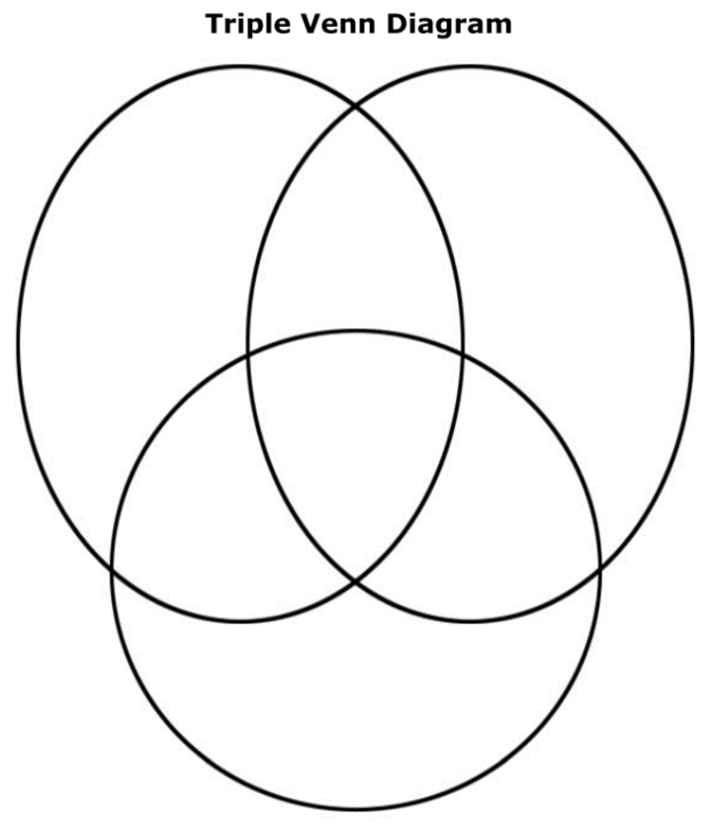
Common Ideas
On the back of the diagram, list the commonalities that you found between all three texts.
Just from the middle section of the Venn Diagram.
For each idea, write down evidence from each text to support the common idea.

Slide 5
Turn in Your Assignement

