Slide 1
Finish Commonalities and Support
Tuesday, 10 March 2020
English 9
Writing About Literature

Slide 2
Do Now 3-10-20
Misplaced modifiers are single words, phrases, or clauses that do not point directly to the word or words they modify.
Rewrite the following sentences, all of which contain misplaced modifiers, so that they make sense.
The first one is done for you.
The actor was a tall man with a red mustache weighing 200 pounds.
The actor was a tall man weighing 200 pounds with a red mustache.
The teacher posted the times for the students discussed in class.
Definitely the most convenient method of travel, Jimmy took the subway to work.
I was told Maurice sent me flowers by my mother.
Sailing toward the floor, Grandma Tina caught her martini glass.

Slide 3
Corrections
The actor was a tall man weighing 200 pounds with a red mustache.
The teacher posted the times discussed in class for the students.
Jimmy took the subway, definitely the most convenient method of travel, to work.
I was told by my mother Maurice sent me flowers.
Grandma Tina caught her martini glass as it was sailing toward the floor,

Slide 4
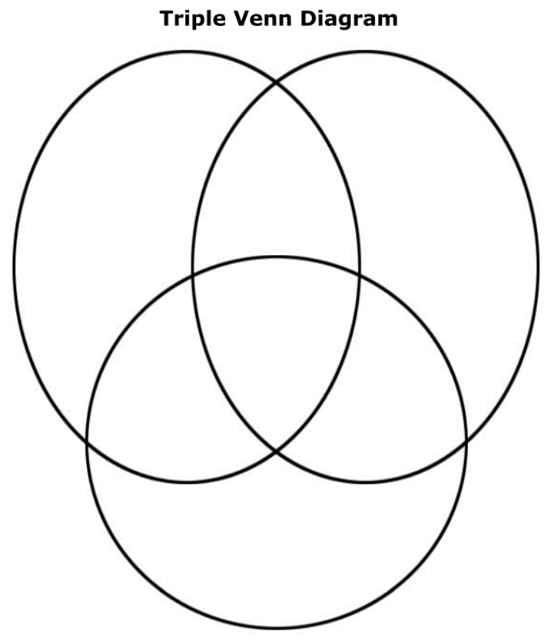
Common Ideas
On the back of the diagram, list the commonalities that you found between all three texts.
Just from the middle section of the Venn Diagram.
For each idea, write down evidence from each text to support the common idea.

Slide 5
Turn in Your Assignment

