Slide 1
Lesson 1 Week of March 23
Creative Writing
Dialogue Story

Slide 2
Hello, It’s Week 2!
This week you are going to write the first draft Dialogue Story
You will compose this in your Creative writing Google Drive Folder.
The following slides will remind you how to create a document in that folder.
Please have your story draft completed by Thursday, March 26.
As always, I will be available to answer question via Google Hangout and Remind Mon-Fri 9-10 am and 1-2 pm. If you are not able to contact me at that time, post your questions and comments when you can, and I will answer them during the next scheduled office hour.

Slide 3
Creating Your Story Document
Log into your gmail account
Go into your Google Drive
Open your English 9 Folder
Click on the New Icon
Then choose Google Docs

Slide 4
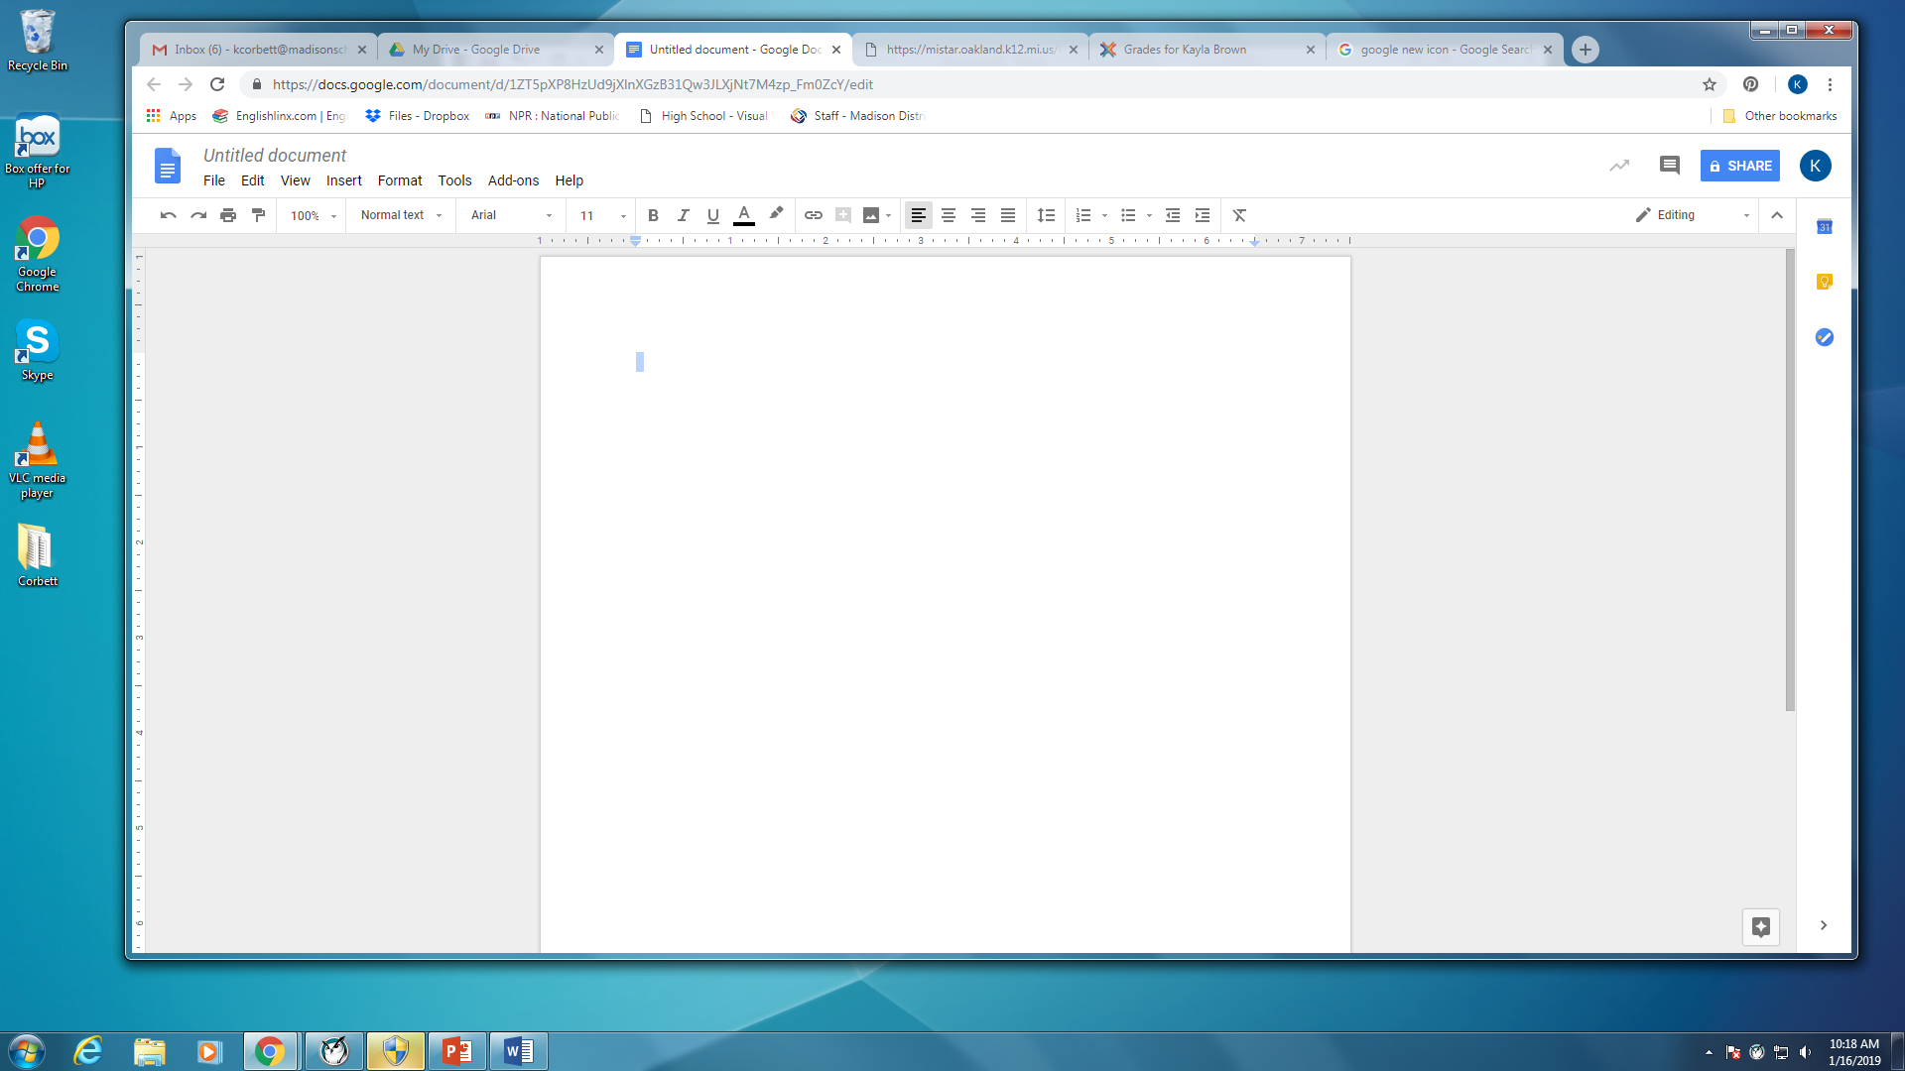
Your new screen should look like this:
There are a couple more things to do before you begin typing your story.

Slide 5
Title Your Document
Click in the box where it says “Untitled Document.
Change it to your Last Name: Dialogue Story

Slide 6
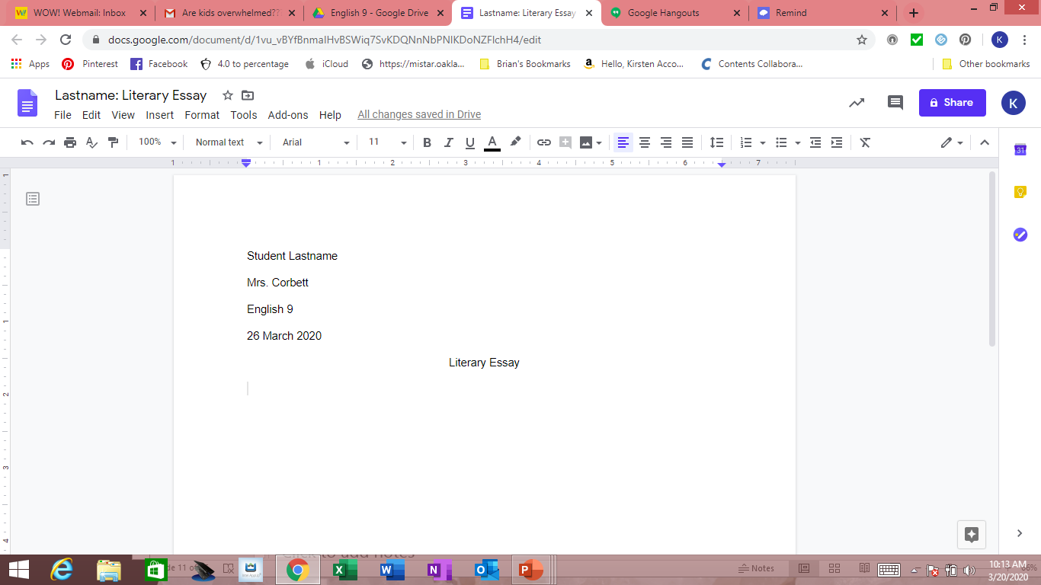
First Page should look like this
Mrs. Corbett is going to show you how.

Slide 7
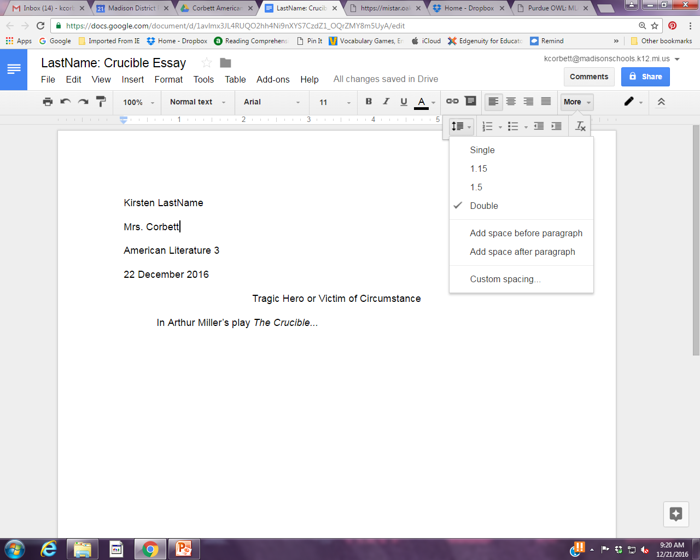
Spacing, Info, and Title
Alignment buttons. Center for title only, Left for Name, etc. and body of paper.
In the upper left corner of the first page only
Your first and last name
Mrs. Corbett
English 9
Date : 26 March 2020
Only hit Enter once after items including your title and to start a new paragraph.
Use the Tab key to indent each new paragraph.
Choose Double space. (you may need to click the more button if the line spacing does not appear)

Slide 8
Begin Typing
If you are finished with your story planning handouts begin typing the rough draft of your story.
If you are not finished, please do so and email a picture to Mrs. Corbett.
Story Requirements
Must have at least three characters (but no more than 5)
Must include dialogue – at least 10 lines throughout the story. This can occur all at once in your story or be scattered throughout. A line of dialogue is one person speaking.
Dialogue must be properly punctuated and formatted.

Slide 9
Closure
Remember, rough draft is due Thursday, March 26.
Lesson 2 will be a check in with things to think about as you are drafting.
Have a good week and remember that Mrs. Corbett is thinking of you and misses seeing you.

