Slide 1
Lesson 1 Week of March 23
English 11
Persuasive Writing

Slide 2
Hello, It’s Week 2!
This week you are going to write the first draft of your Persuasive Essay.
You will compose this in Google Docs.
The following slides will remind you how to create a document and share it with Mrs. Corbett.
Please have your essay draft completed by Thursday, March 26.
As always, I will be available to answer question via Google Hangout and Remind Mon-Fri 9-10 am and 1-2 pm. If you are not able to contact me at that time, post your questions and comments when you can, and I will answer them during the next scheduled office hour.

Slide 3
Open Your Google Drive
Log in to your Gmail account
Click on the apps icon and choose Drive.
That should get you to a screen that looks something like this:

Slide 4
Create a New Document
Click on the New Icon
Then choose Google Docs

Slide 5
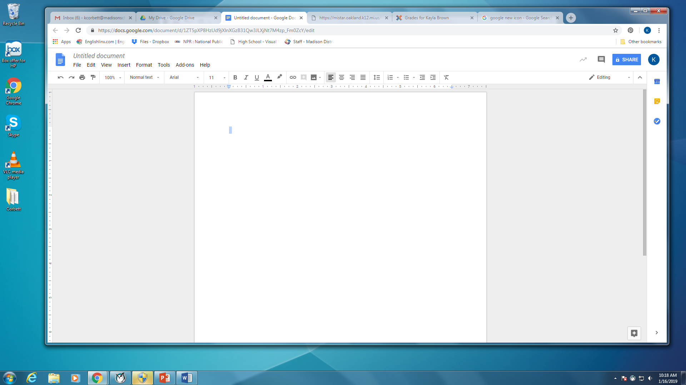
Your new screen should look like this:
There are a couple more things to do before you begin typing your essay.

Slide 6
Title Your Document
Click in the box where it says “Untitled Document.
Change it to your Last Name, First Name: Persuasive Essay
For Example:

Slide 7
Share with Mrs. Corbett
Click on the Share button
In this box, type Mrs. Corbett’s email address: kcorbett@madisonschools.k12.mi.us
Click Done

Slide 8
Formatting your Essay
Upper right-hand corner:
Your name
Mrs. Corbett
English 11
13 February 2020
Working title centered.
You will change the title later, so don’t worry about it now.

Slide 9
Type Your Essay
Google Drive automatically saves your work.
Do not change the font or font size.

Slide 10
Drafting Your Composition
Use your Prewriting activities as your guide to your essay.
Your thesis statement is the last sentence of your introduction.
You must have 5 full paragraphs.

Slide 11
Essay Structure
5 Paragraphs- Use your Essay Outline as a guide.
Introduction- End with Thesis
Body Paragraph #1 – First reason for your idea
Body Paragraph #2 – Second reason for your idea
Body Paragraph #3 – Third and strongest reason for your idea
Conclusion-Begin with Thesis

Slide 12
Closure
Remember, rough draft is due Thursday, March 26.
Lesson 2 will be a check in with things to think about as you are drafting.
Have a good week and remember that Mrs. Corbett is thinking of you and misses seeing you.

