Slide 1
Lesson 1 Week of March 23
English 9
Writing About Literature

Slide 2
Hello, It’s Week 2!
This week you are going to write the first draft of your Literary Essay.
You will compose this in your English 9 Google Drive Folder.
The following slides will remind you how to create a document in that folder.
Please have your essay draft completed by Thursday, March 26.
As always, I will be available to answer question via Google Hangout and Remind Mon-Fri 9-10 am and 1-2 pm. If you are not able to contact me at that time, post your questions and comments when you can, and I will answer them during the next scheduled office hour.

Slide 3
Creating Your Essay Document
Log into your gmail account
Go into your Google Drive
Open your English 9 Folder
Click on the New Icon
Then choose Google Docs

Slide 4
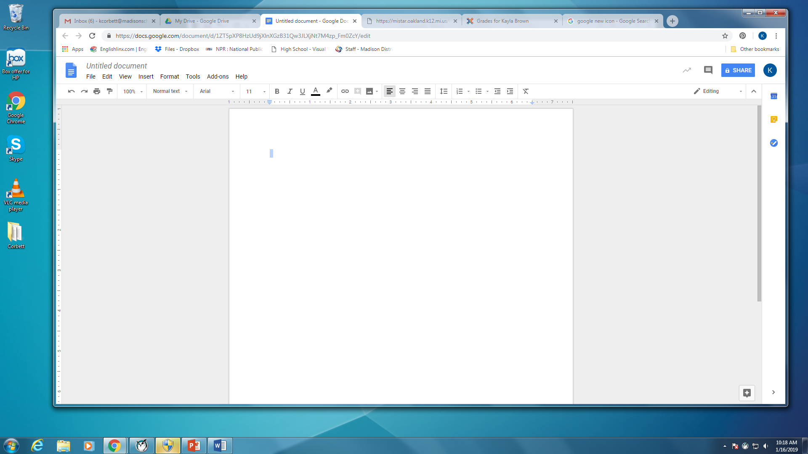
Your new screen should look like this:
There are a couple more things to do before you begin typing your essay.

Slide 5
Title Your Document
Click in the box where it says “Untitled Document.
Change it to your Last Name: Literary Essay

Slide 6
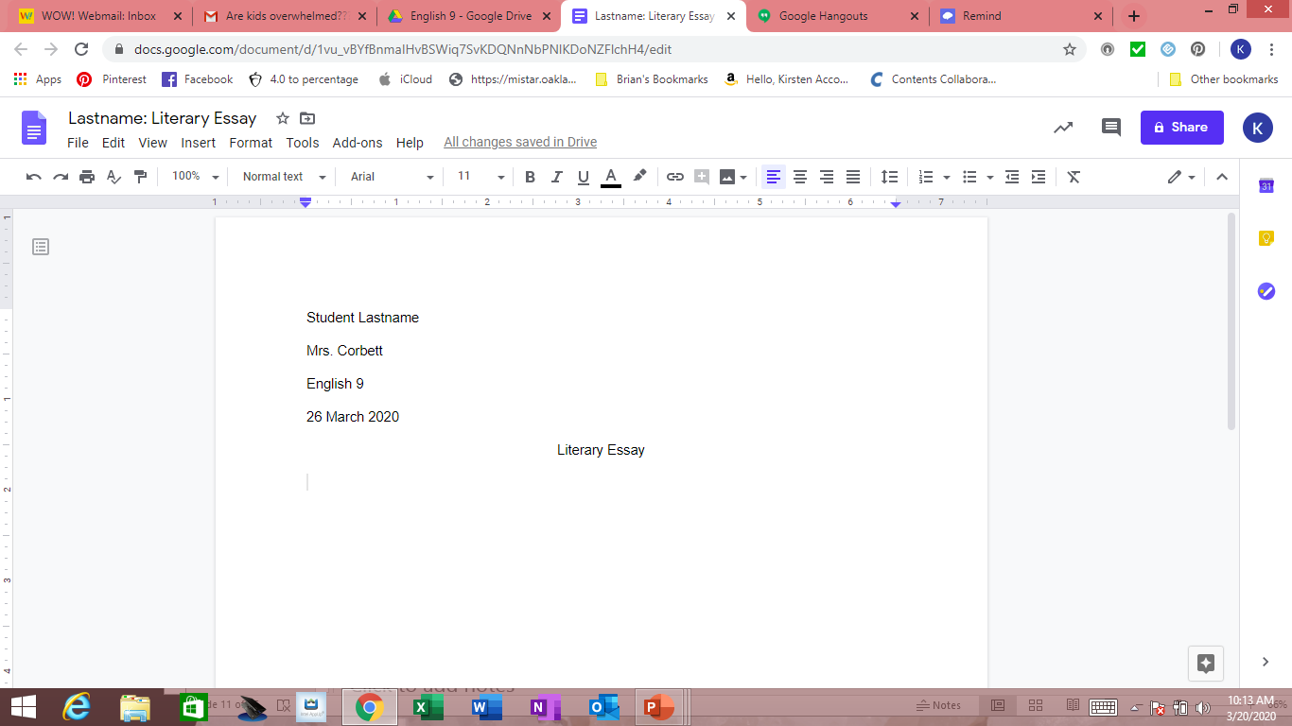
First Page should look like this
Mrs. Corbett is going to show you how.

Slide 7
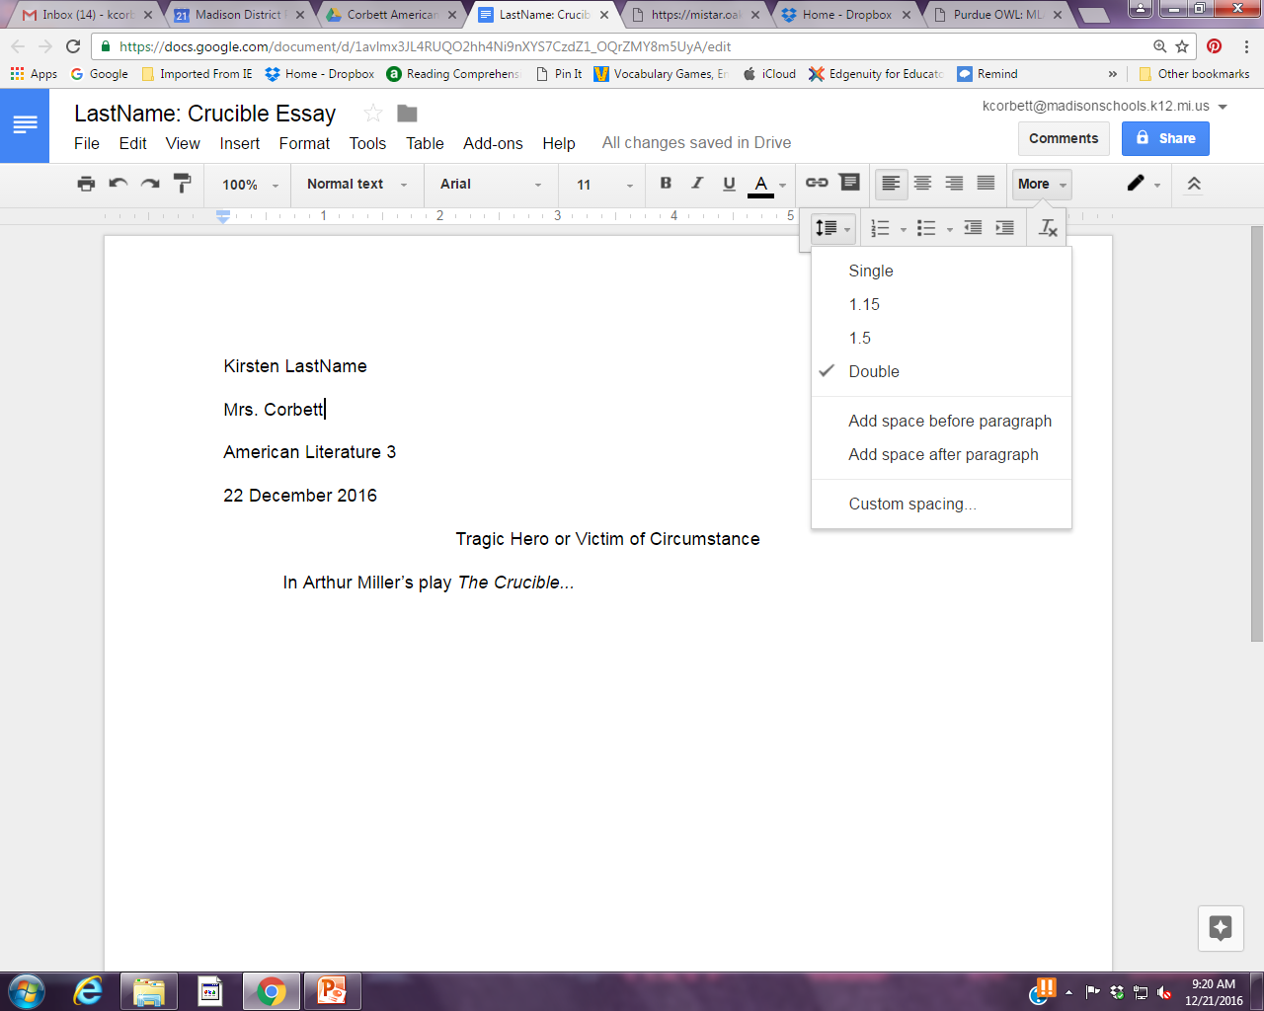
Spacing, Info, and Title
Alignment buttons. Center for title only, Left for Name, etc. and body of paper.
Choose Double space. (you may need to click the more button if the line spacing does not appear)
In the upper left corner of the first page only
Your first and last name
Mrs. Corbett
English 9
Date : 26 March 2020 (that is the due date for your rough draft.)
Only hit Enter once after items including your title and to start a new paragraph.
Use the Tab key to indent each new paragraph.

Slide 8
Begin Typing
If you are finished with your 5 Paragraph Essay Outline begin typing the rough draft of your essay.
If you are not finished, please do so and email a picture to Mrs. Corbett.
Essay Structure
Introduction Paragraph – Grab your reader’s attention with relevant information about the theme you have chosen. End with your thesis statement.
Body Paragraph #1 – Explain how the first text deals with the theme. Provide at least 2 concrete examples and details from the text.
Body Paragraph #2 - Explain how the second text deals with the theme. Provide at least 2 concrete examples and details from the text.
Body Paragraph #3 - Explain how the third text deals with the theme. Provide at least 2 concrete examples and details from the text.
Conclusion Paragraph – Begin with your thesis, then wrap up by summarizing the information presented in your body paragraphs.

Slide 9
Closure
Remember, rough draft is due Thursday, March 26.
Lesson 2 will be a check in with things to think about as you are drafting.
Have a good week and remember that Mrs. Corbett is thinking of you and misses seeing you.

